Slide 1
Pulse Check Decisions

Slide 2
Scenario
You respond to a code blue on E50 and upon arrival you see a nurse performing chest compressions on a patient in bed
You establish yourself as the code leader while the rest of the team arrives
What are your next steps?

Slide 3
At first Pulse Check…
No pulse
Notes:
Fine vfib, shock

Slide 4
After resuming CPR
Nurse tells you she is having difficulty feeling a pulse even during compressions
How else can we detect ROSC?

Slide 5
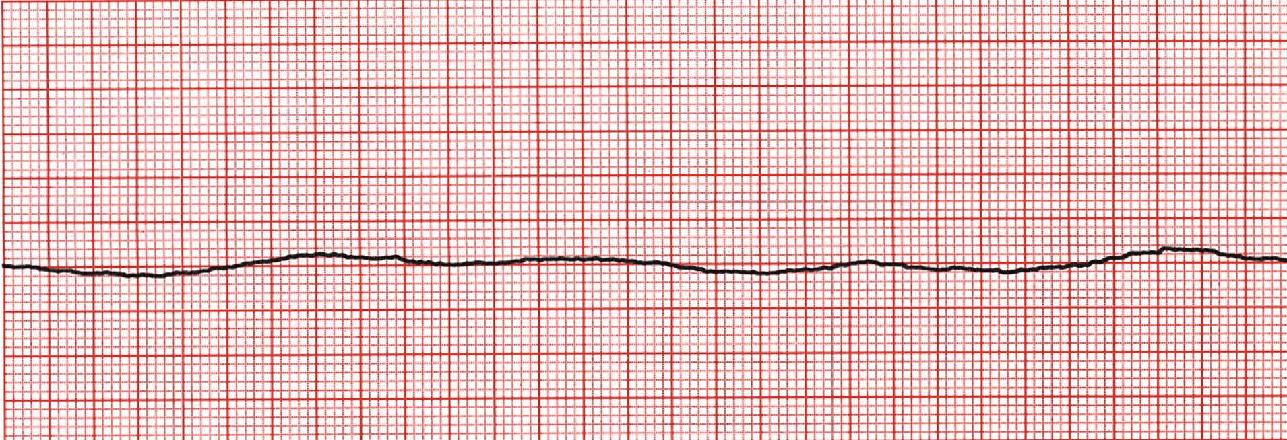
At next pulse check…
No pulse
Just prior to resuming compressions, anesthesia is ready to intubate but asks for a bit more time
Thoughts?

Slide 6
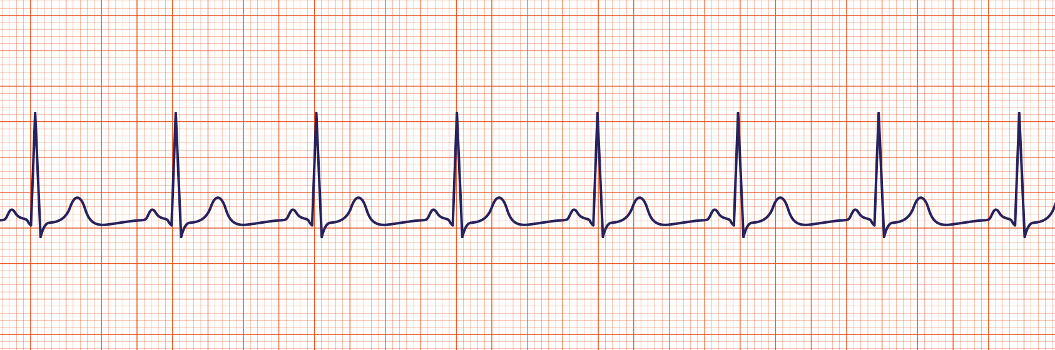
At next pulse check
ETCO2 = 36

Slide 7
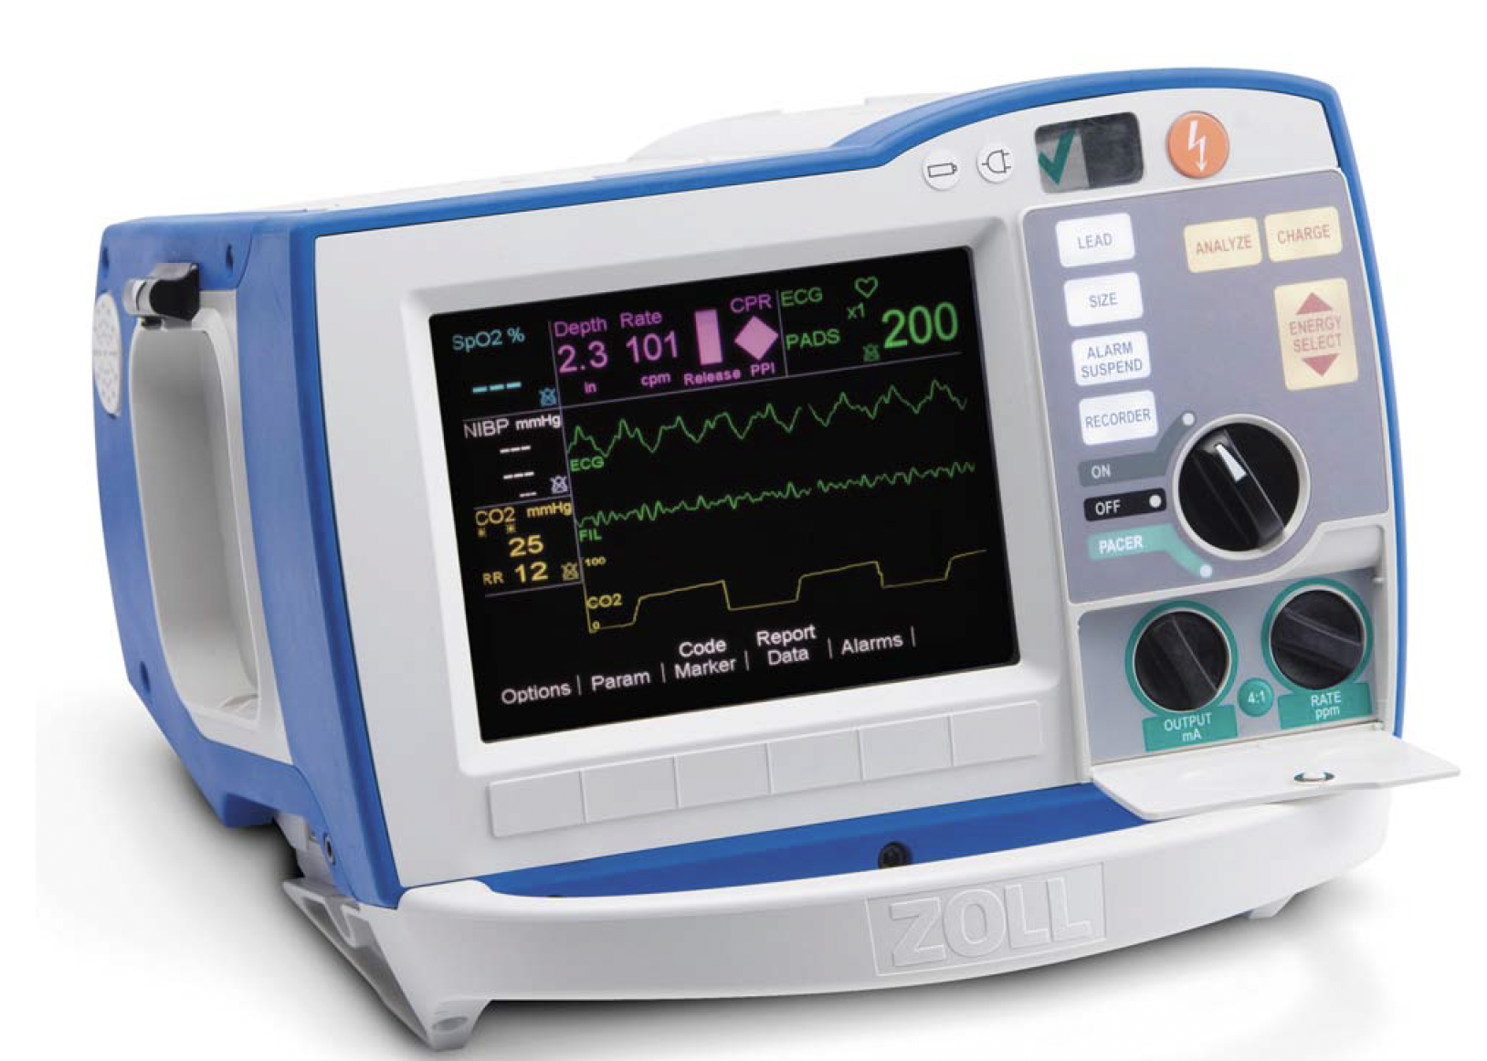
What can you do when you’re unsure?
Enroll help (the nurses are good)
“Are we certain this is asystole?"
Turn up the gain

Slide 8
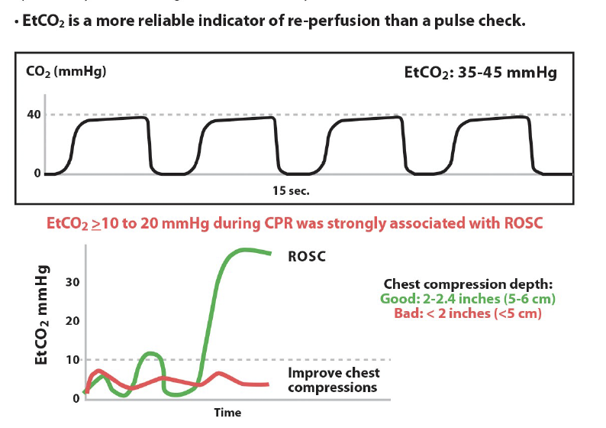

What if the pulse is hard to feel?
10 second pause, total
Use doppler
Use EtCO2 to help detect ROSC

Slide 9
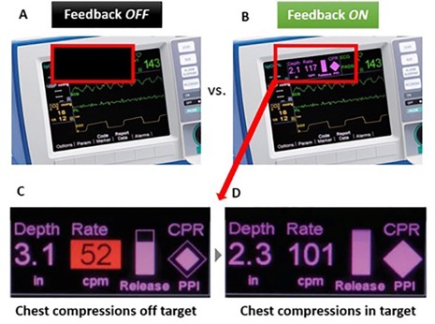
What is the big picture?
If they don’t have a pulse, someone is compressing the chest with high quality CPR. NO significant breaks.
Minimize pauses to necessary position changes, pulse checks, and a little wiggle room to the Lucas or intubation (but only a little)
Shock them if they have a shockable rhythm
The rest (mostly*) not so important
Notes:
Survival from witnessed ventricular fibrillation (VF) decreases by 10–12% for every minute defibrillation is delayed [3, 4], but when CPR is provided the decline in survival is only 3-4% per minute
Utilize code team members – 1 to check pulse and 1 to monitor tele/zoll monitor
Spend only 10 seconds checking for a pulse to minimize interruptions in CPR
You don’t want house md at your code. Don’t try to diagnose lupus in a code.
The rest is whatever (people will be fired up about all sorts of things, but they don't matter). It’s a bonus if you figure out why they coded, but it’s a small, small minority where the etiology is not blindingly obvious but is also easily reversible.
LUCAS: institution policies vary, but
Negative RCT in OHCA - DOI:https://doi.org/10.1016/S0140-6736(14)61886-9
Negative retrospective data in IHCA - https://doi.org/10.1016/j.resuscitation.2024.110142
The only time it may be important is ECMO/long resusc with procedure.
IF pause in compression is more than a few seconds, USE YOUR CRED HERE.

Slide 10
Summary: Pulse Check Decisions
DO NOT MISS FINE V. Fib
Only allow, at most, a few seconds of CPR delay for Lucas / Intubation
This is a decision to spend your “political capital” on
Use EtCO2

